Slide 1
Safeguarding Update
All Staff Sep 2017

Slide 2
Reference to other school policies (please review at least the red bullet point policies)*
Anti-Bullying Policy
Attendance Policy
Community Cohesion Policy
Health and Safety Policy
Illicit and Unauthorised Substances Policy
Managing Behaviour Policy
Safeguarding Policy
Sex and Relationship Education Policy
Supporting Students who have Medical Conditions
Whistleblowing Policy
* http://www.emmbrook.wokingham.sch.uk/our-school/school-policies/

Slide 3
Objective: to cover the key aspects of the latest L1 safeguarding training vis-à-vis Ofsted requirement
LEVEL 1 Safeguarding and Child Protection Awareness
Course outline
Module One: Introduction
Module Two: Recognising the Signs of Abuse
Module Three: Responding to a Disclosure
Module Four: Reporting Your Concerns
Module Five: Recording Information
Note that subsequent (INSET) updates will seek to develop understanding around these modules

Slide 4
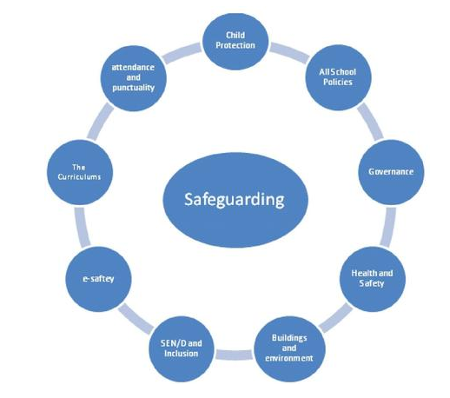
Difference between safeguarding and child protection
Safeguarding, and promoting the welfare of children, is a broader term than child protection. It encompasses protecting children from maltreatment, preventing impairment of children's health or development, and ensures children grow up in safe circumstances.
Child protection is part of this definition and refers to activities undertaken to prevent children suffering, or likely to suffer, significant harm.

Slide 5
What is child abuse?
https://www.nspcc.org.uk/preventing-abuse/signs-symptoms-effects/

Slide 7
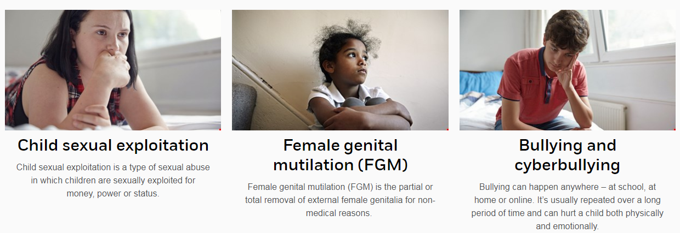

Slide 8
You are encouraged to maintain an attitude of ‘it could happen here’ where safeguarding is concerned.

Slide 9
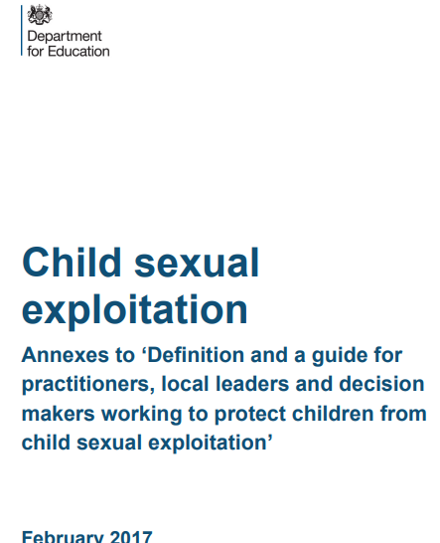
A child is anyone who has not yet reached their 18th birthday. Throughout this advice the terms ‘child’ and ‘children’ are used to refer to all those under the age of 18.
Child sexual exploitation is a form of child sexual abuse. It occurs where an individual or group takes advantage of an imbalance of power to coerce, manipulate or deceive a child or young person under the age of 18 into sexual activity (a) in exchange for something the victim needs or wants, and/or (b) for the financial advantage or increased status of the perpetrator or facilitator. The victim may have been sexually exploited even if the sexual activity appears consensual. Child sexual exploitation does not always involve physical contact; it can also occur through the use of technology.
Who is vulnerable to child sexual exploitation?
Any child, in any community
Children aged 12-15 years of age are most at risk
most frequently observed amongst young females; boys are also at risk
Child sexual exploitation affects all ethnic groups
Although the legal age of consent for sexual activity is 16, the SOA recognises the continued vulnerability of 16- and 17-year-olds in particular circumstances.
https://www.gov.uk/government/uploads/system/uploads/attachment_data/file/591905/CSE_Guidance_Annexes_13.02.2017.pdf

Slide 10
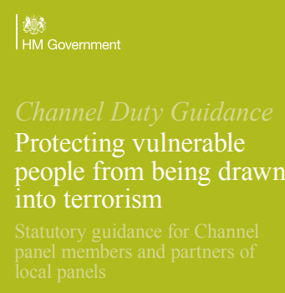
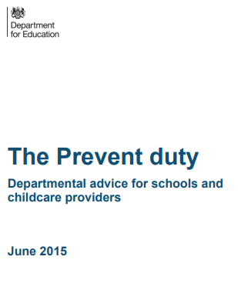
Protecting children from the risk of radicalisation should be seen as part of schools’ and colleges’ wider safeguarding duties
Radicalisation refers to the process by which a person comes to support terrorism and forms of extremism
Extremism is vocal or active opposition to fundamental British values, including democracy, the rule of law, individual liberty and mutual respect and tolerance of different faiths and beliefs. We also include in our definition of extremism calls for the death of members of our armed forces, whether in this country or overseas.
to have “due regard” to the need to prevent people from being drawn into terrorism”. This duty is known as the Prevent duty. Schools are expected to assess the risk of children being drawn into terrorism, including support for extremist ideas that are part of terrorist ideology.
School and college staff should understand when it is appropriate to make a referral to the Channel programme
https://www.gov.uk/government/uploads/system/uploads/attachment_data/file/550499/Keeping_children_safe_in_education_Part_1.pdf
http://educateagainsthate.com/

Slide 11
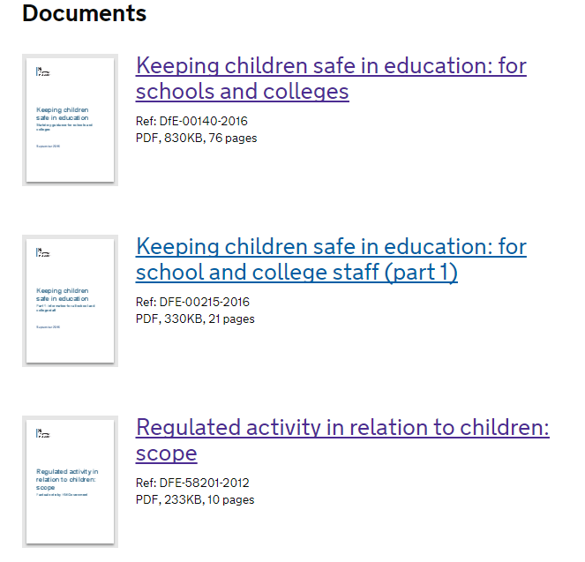
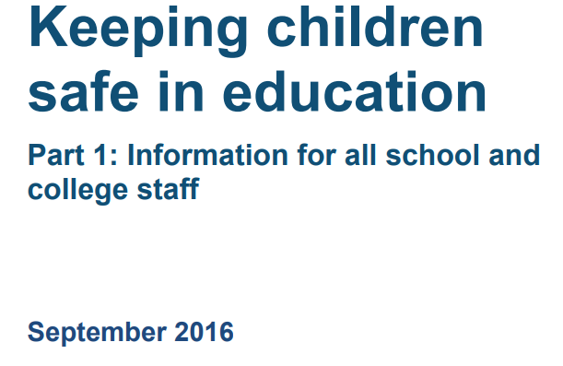
Safeguarding and promoting the welfare of children is everyone’s responsibility.
starting point for all staff in schools
If children and families are to receive the right help at the right time, everyone who comes into contact with them has a role to play in identifying concerns, sharing information and taking prompt action.
Children includes everyone under the age of 18.
All school and college staff have a responsibility to provide a safe environment in which children can learn.
new
The Teachers’ Standards 2012 state that teachers, including headteachers, should safeguard children’s wellbeing and maintain public trust in the teaching profession as part of their professional duties.
All staff should be aware of the process for making referrals
All school and college staff members should be aware of the types of abuse and neglect
All concerns, discussions and decisions made and the reasons for those decisions should be recorded in writing
https://www.gov.uk/government/uploads/system/uploads/attachment_data/file/592101/Working_Together_to_Safeguard_Children_20170213.pdf

Slide 12
A child going missing from education is a potential indicator of abuse or neglect and such children are at risk of being victims of harm, exploitation or radicalisation.
It is important that the admission register is accurate and kept up to date
So-called ‘honour-based’ violence (HBV) encompasses crimes which have been committed to protect or defend the honour of the family and/or the community, including Female Genital Mutilation (FGM), forced marriage, and practices such as breast ironing.
Where FGM has taken place, since 31 October 2015 there has been a mandatory reporting duty placed on teachers
Forcing a person into a marriage is a crime in England and Wales. The Forced Marriage Unit (FMU) has published Multi-agency guidelines

Slide 13
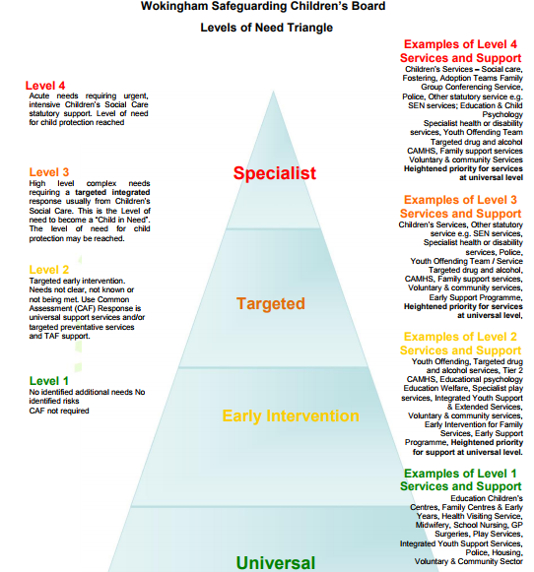
Threshold document for levels of need and intervention
If you believe a child is in immediate danger call the Police on 999
http://wokinghamlscb.org.uk/Levels_of_Need_and_Intervention_-_Thresholds

Slide 14
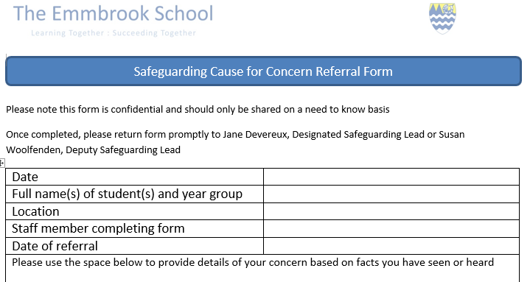
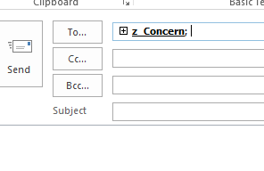
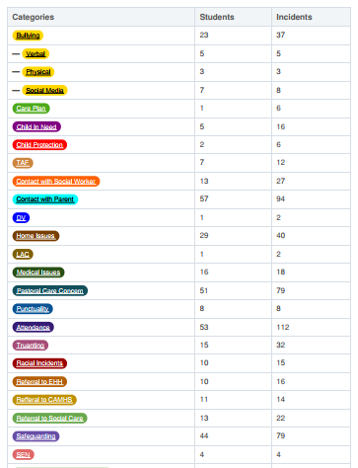
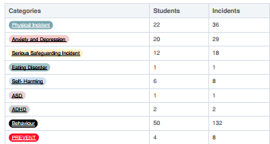
You Reporting
Safeguarding Team
+
=
584 incidents across 151 students from January 5th to July 22nd

Slide 15
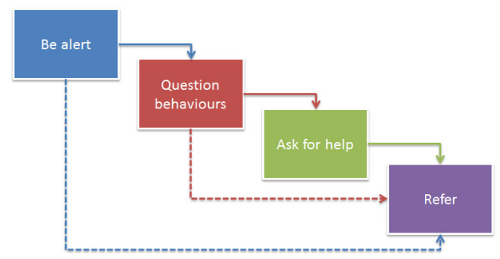
All staff should know what to do if a child tells them he/she is being abused or neglected. Staff should know how to manage the requirement to maintain an appropriate level of confidentiality whilst at the same time liaising with relevant professionals such as the designated safeguarding lead and children’s social care. Staff should never promise a child that they will not tell anyone about an allegation, as this may ultimately not be in the best interests of the child.

Slide 16
What do I do as a teacher if a child asks to talk to them about a problem?
• Do not promise them confidentiality
• Listen to the student
• Write down the initial details of the disclosure in the words used by the student
• Do not say words for them, however embarrassed they are to say them
• Do not get them to give too much detail but sufficient to make you concerned about the nature for their disclosure. You are not the investigator.
• Immediately after the conversation, speak to the safeguarding team
• Never ‘leave ‘ any situation for a few days to allow you or the child to ‘think about it’ – the child could be at risk. • Do not contact any outside agency yourself.
Where do we hold the meeting? If a child asks to talk to you about something personal, please make sure of the following:
• Go somewhere quiet but make sure there are people near to the room you are in.
• Do not shut the door – make sure it stays open

Slide 17
