Slide 1




Apprenticeship Support and Knowledge for Schools

Slide 2

What are apprenticeships?

Slide 3
Some of the possibilities

Slide 4
LEVELS OF APPRENTICESHIP
TRAINEESHIPS
INTERMEDIATE APPRENTICESHIP
LEVEL 2
12 – 18 MONTHS
ADVANCED APPRENTICESHIP
LEVEL 3
12 – 36 MONTHS
HIGHER/DEGREE APPRENTICESHIP
LEVELS 4, 5, 6 & 7
12 – 48 MONTHS
SKILLS, KNOWLEDGE AND COMPETENCIES

Slide 5


You get paid and you have a career
National Minimum Wage £3.40 per hour
Average wage £170 per week
Wage depends on the employer – many pay more than Minimum Wage

Slide 6
Are there any jobs?
Over 28,000 apprenticeship vacancies advertised each year
5 miles = 92 apprenticeships
10 miles = 313 apprenticeships
15 miles = 603 apprenticeships
20 miles = 896 apprenticeships

Slide 7
Apprenticeship jobs in this area:
Job opportunity | LEVEL | DURATION | Closing date | Weekly salary | Annual salary
Media & IT Executive Apprentice Challenger Sports UK Ltd | Advanced (Level 3) | 24 months | 10th February 2017 (to start February 2017) | £150.00 | £7,800
Childcare Apprenticeship Goldilocks Day Nursery | Advanced (Level 3) | 12 months | 26th February 2017 (to start March 2017) | £136.00 | £7,072
Mechanical Engineering - Advanced Apprenticeship Xtrac Ltd | Advanced (Level 3) | 36 months | 3rd March 2017 (to start September 2017) | £312.00 | £16,224
HR and Legal Support Apprentice Phillips | Higher (Level 4) CIPD Level 5 in HR Management | 24 months | 28th February 2017 (to start March 2017) | £250.00 | £13,000
Degree Apprenticeship Cgi It Uk Ltd | Degree (Level 6) | 54 months | 13th February 2017 (to start September 2017) | £271.15 | £14,100

Slide 8

There’s never been a better time…
The world of work and career opportunities just got a whole lot more exciting …really!

Slide 9
Higher and Degree apprenticeships
Now its possible to get a degree without going to uni…

Slide 10

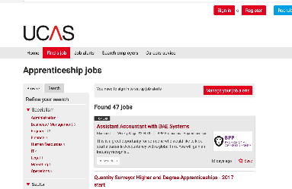
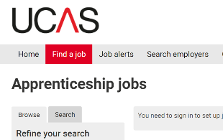
University – have a plan A and B
https://careerfinder.ucas.com/jobs

Slide 11
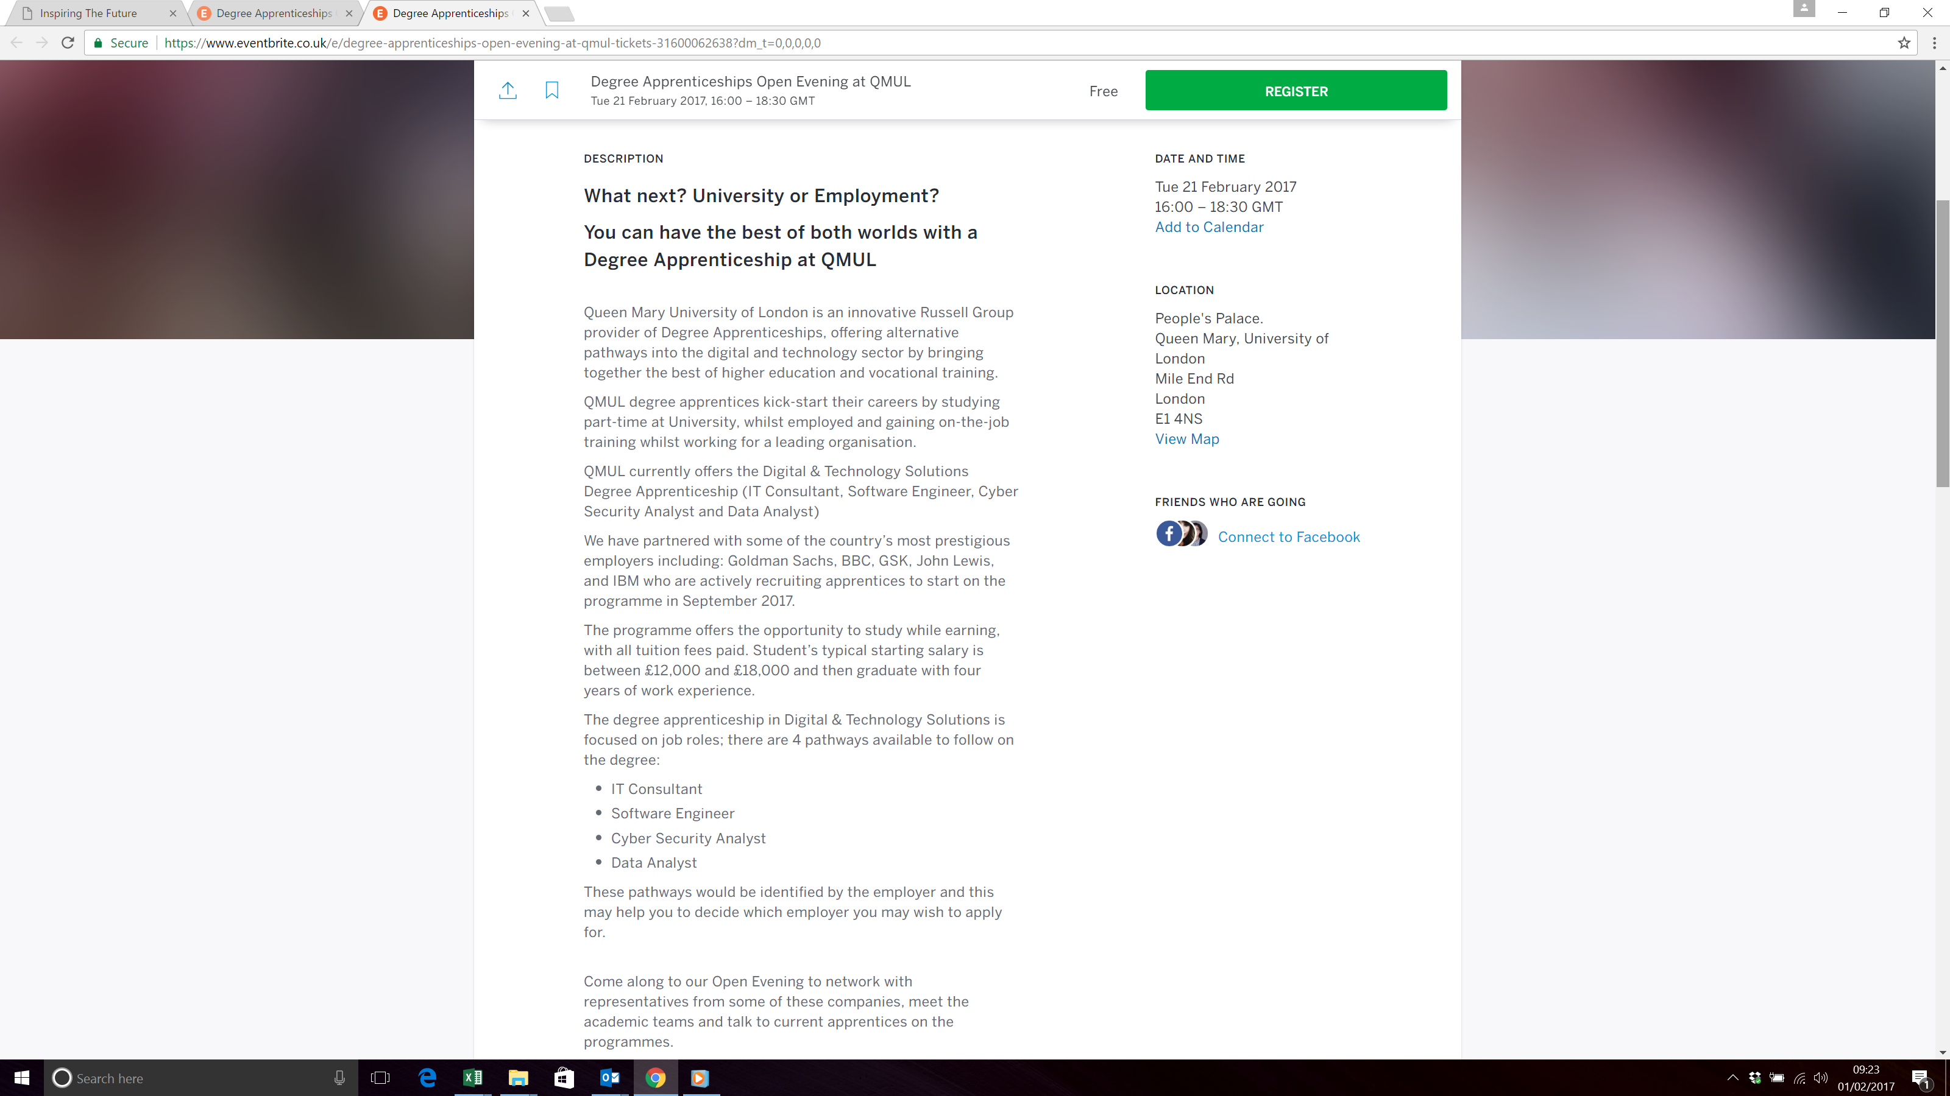
Degree Apprenticeship Event – Queen Mary’s London 21st February

Slide 12
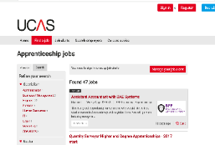
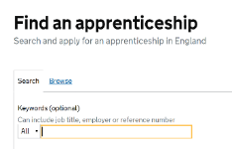
How do you find an apprenticeship?
Register on Find an apprenticeship
(Ideally create an account & respond to your email to activate it)
Do your research and search for jobs
Start applying
Manage your alerts
Make contact with the companies

Slide 13
Activate your account:
You complete the Information card and hand it to me or Mrs Spencer as you leave.
I register you on the Find An Apprenticeship database.
I will email you with confirmation of your registration, your password and the web address.
You will receive an email from Find An Apprenticeship with an activation code. Type this in to the Code box on the website and your account will be live.
You can log in and search for Apprenticeships.
Set up Alerts to your phone and/or email. You will then receive texts and/or email alerts that you set up for your searches
Save Apprenticeships to look at later.
You can Apply for Apprenticeships
Note: If you do not want to be registered on Find An Apprenticeship, please complete the card and write ‘No’ in the top right hand corner.

Slide 14
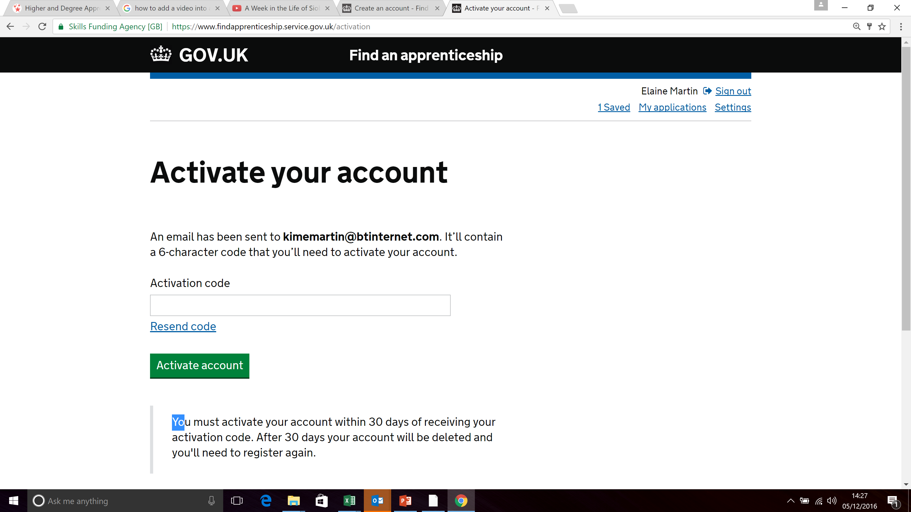
NAME
Email address

Slide 15
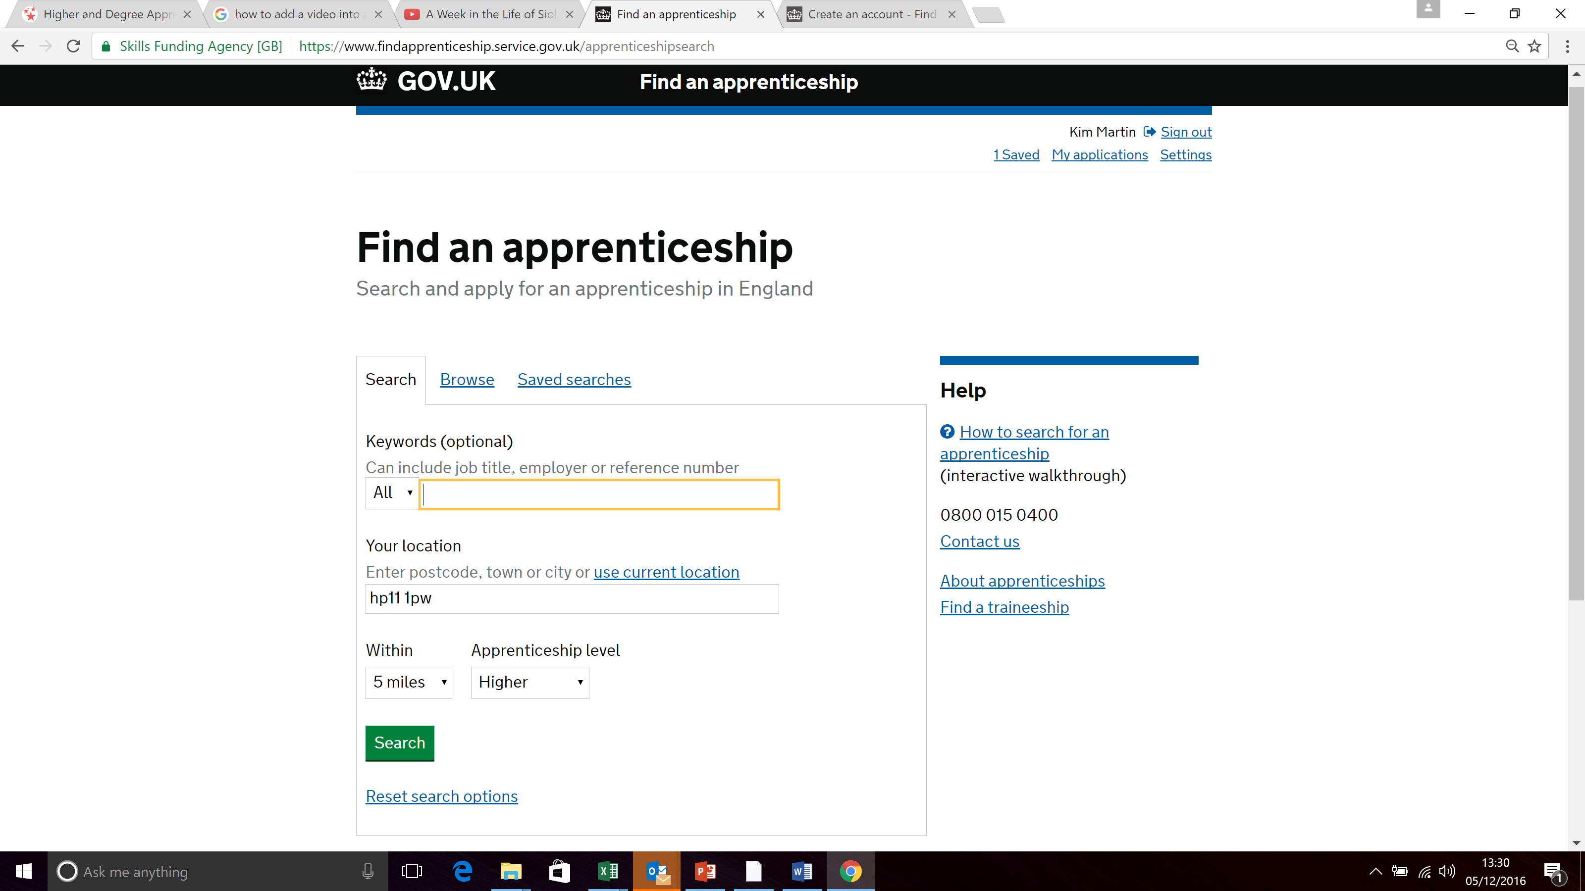
Enter any keywords, your home postcode, how far you can travel and level of apprenticeship

Slide 16
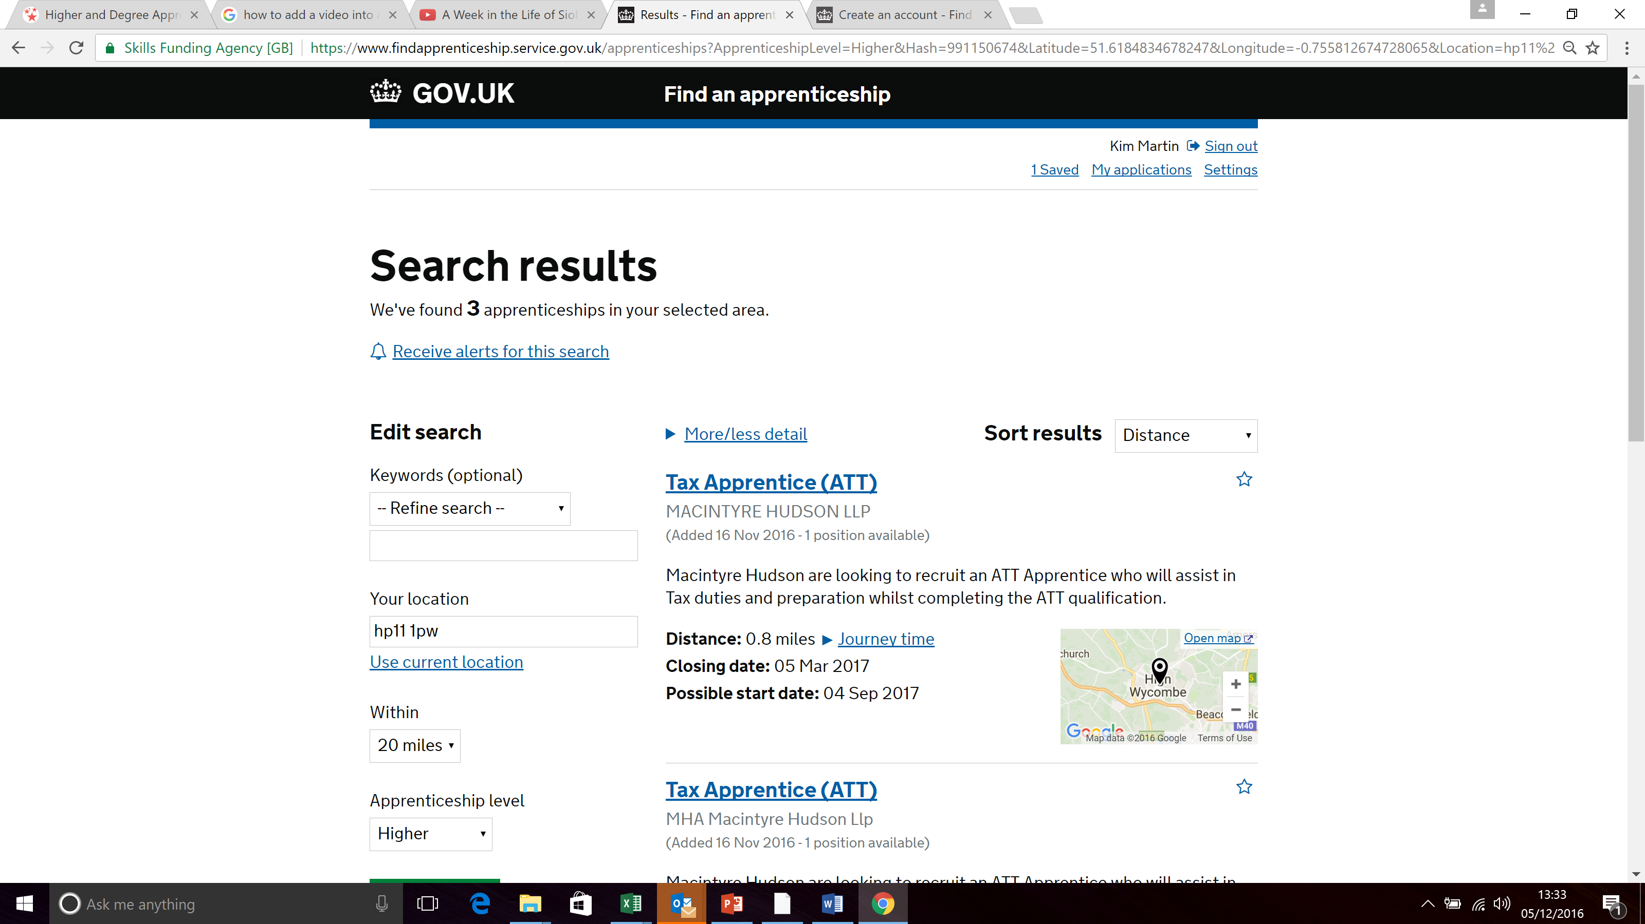
Click ‘Receive alerts for this search’ to have new vacancies sent to your mobile phone and /or email.
Click on the Job title to see further details of the role and the training.

Slide 17
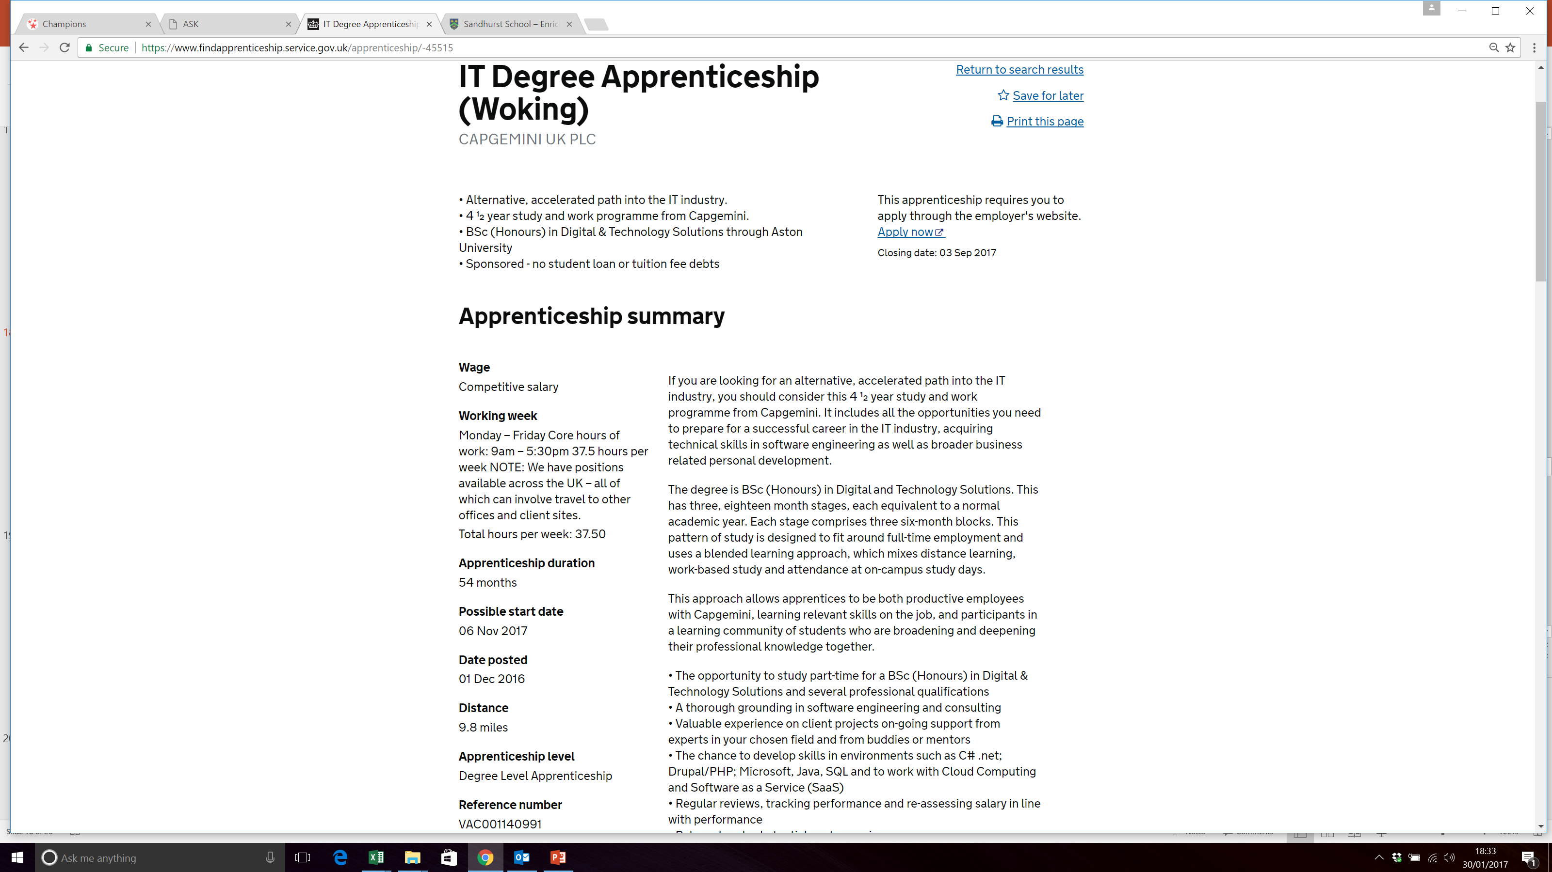
Look at the details.
You can Save the job to refer to later or Print the page

Slide 18
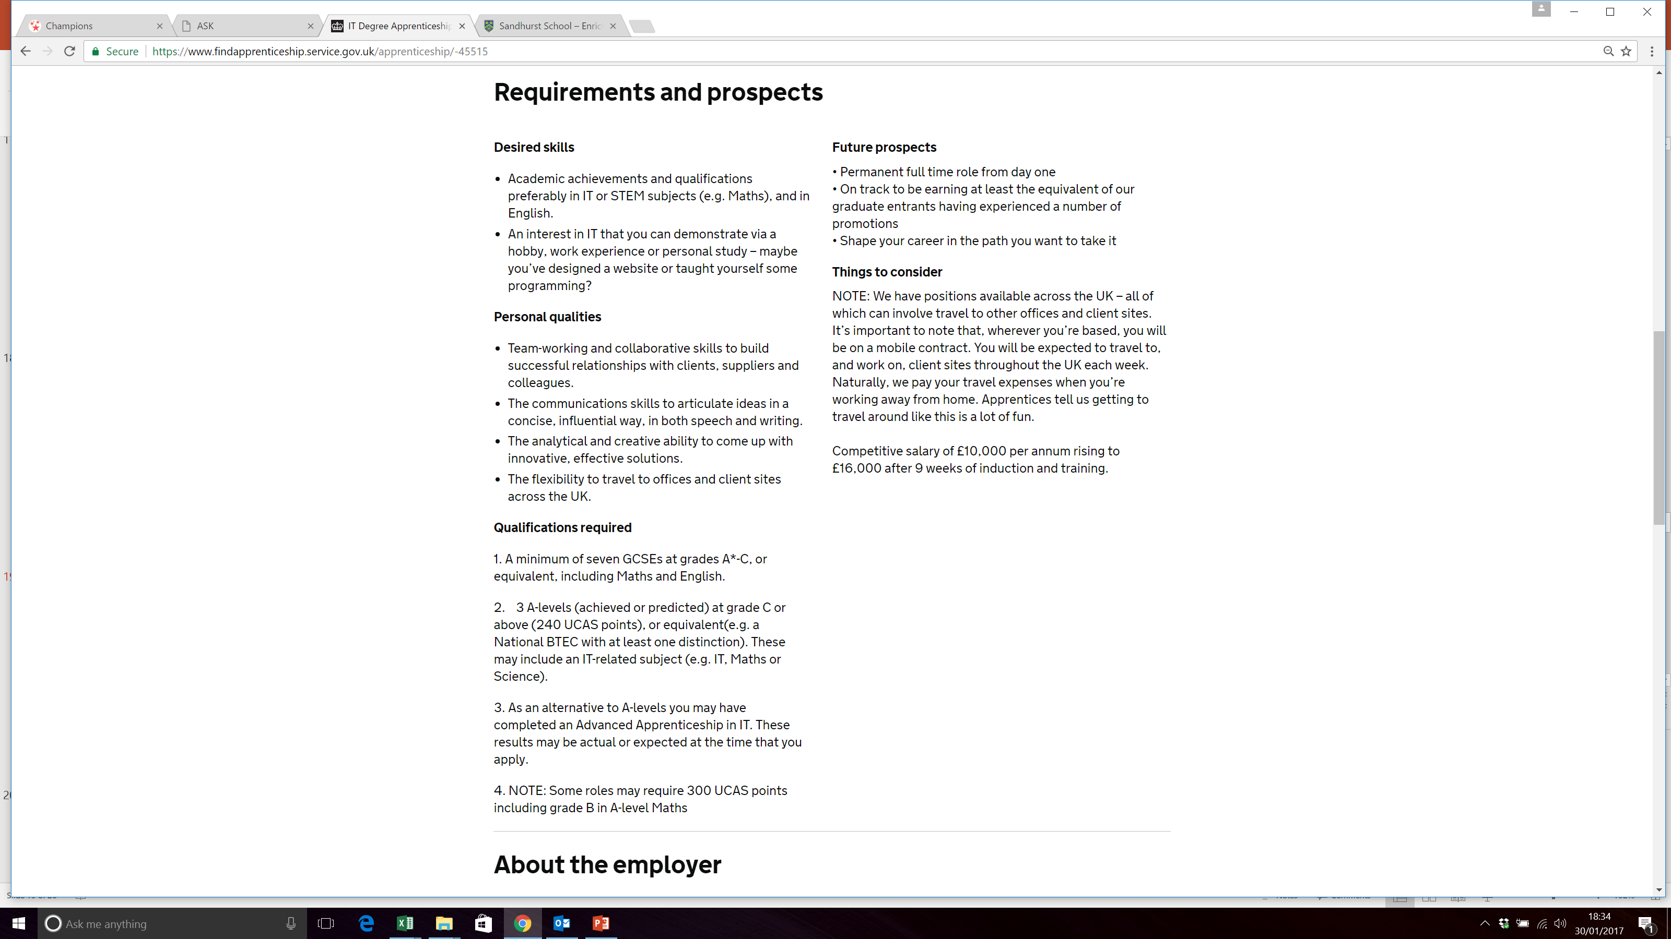

Slide 19
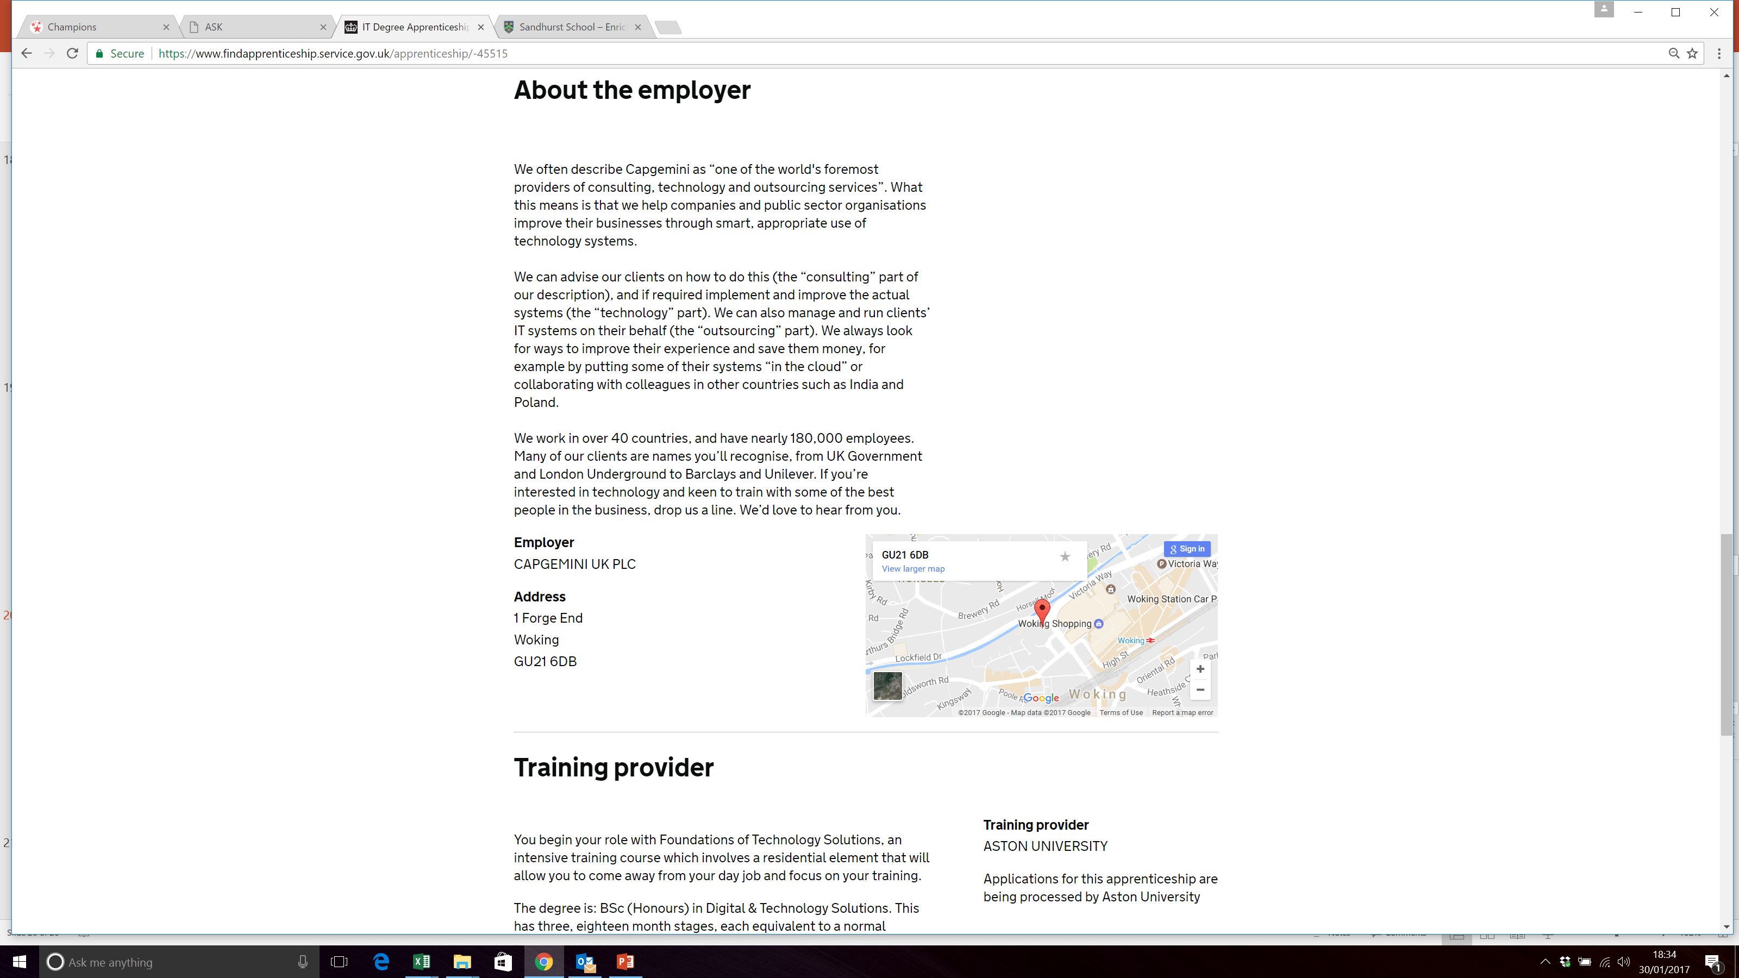

Slide 20

The Apprenticeship
Guide
Sophie to provide front cover
Find out about the latest apprenticeships available
Build your knowledge of starting salaries and progression opportunities
Read about real apprentices in real jobs

Slide 21
An apprenticeship is:
learn
Work
+ = apprenticeships
How many different types of apprenticeships job roles are there?
1500 job roles
How many apprenticeships are advertised on a daily basis?
28,000
What % of apprentices stay in employment at the end of their apprenticeship?
90%
What year at school must your complete before you can start an apprenticeship?
Year 11
What is the on-line system called where you can search and apply for apprenticeship jobs?
Find an apprenticeship
What must you do once you have been registered on ‘Find an apprenticeship’?
Activate the account
Nothing, it is free of charge
How much does it cost to register on Find an apprenticeship?

Slide 22

What next?
We can help!
We can run sessions for those who want help to search and apply for apprenticeships.
Speak to me today, tick the box on your info card to say you would like help with applications or ask Mrs Spencer to contact me

Slide 23
Any questions?

