Slide 1




Careers in Berkshire:
Local labour market information
2016/17

Slide 2
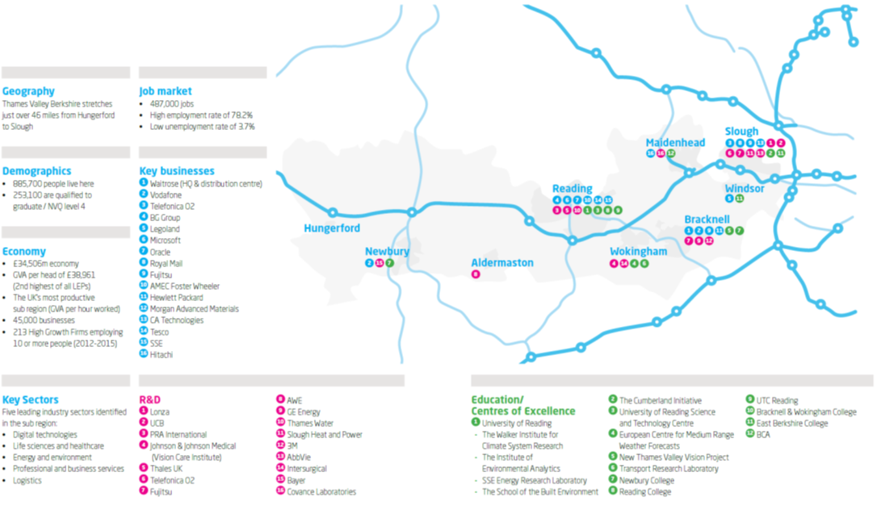
The Thames Valley Berkshire area
This presentation provides information on career opportunities in the Thames Valley Berkshire area.
Thames Valley Berkshire stretches from Hungerford in the West, to Slough in the East.

Slide 3
Key facts
There are many more jobs in the ICT / digital technology sector in Berkshire than elsewhere in England (14% of all jobs in Berkshire are in this sector).
Those working in this sector mainly work in IT, sales, marketing and project management roles.
The local labour market - % jobs by sector

Slide 4

Key facts
There are a large number of ‘big name’ employers in Berkshire.
There are more international companies in Berkshire than elsewhere in the UK (outside of London).
Many jobs with these companies provide the opportunity for overseas travel.
The local labour market – large employers

Slide 5
Key fact
27% of all jobs in Berkshire are classified as STEM jobs, compared to 22% across England as a whole.
The importance of Science, Engineering,
Maths and Technology (STEM)
STEM jobs in Berkshire
STEM jobs in England
27% of jobs are STEM jobs
22% of jobs are STEM jobs
Notes:
Source: EMSI Analyst, 2015

Slide 6

Key facts
68% of jobs in Berkshire are in small or medium-sized companies.
Interested in working for a large global company or a small start-up business? The private, public or voluntary sector? Or working for yourself?
14% of people working in Berkshire are self-employed.
Most young people who are self-employed work in construction, hairdressing and arts / literary occupations.
81% of Berkshire residents work in the private sector and 19% in the public sector (including the NHS, schools, local government and emergency services).

Slide 7


Key fact
IT and sales roles are in high demand by employers in Berkshire.
1 in 10 jobs in Berkshire are IT specialist roles.
This is three times the national average.
Jobs in highest demand in Berkshire – 2016*
  Software developer/engineer
  Sales representative
  Computer support specialist
  Network engineer/architect
  Registered General Nurse
  Project manager
  Retail supervisor
  Customer service representative
  Office/administrative assistant
  Sales manager
*Measured by the number of vacancies being advertised

Slide 8
Key fact
The number of local job opportunities in different sectors / occupations varies considerably.
In IT, whilst there are lots of jobs, the skills required are very specific and therefore employers can struggle to fill roles.
Are there many jobs locally in…?
Sector / occupation | Number of jobs in Berkshire | Level of competition for jobs? | Examples of employers
IT / Software development | 51,000 | Low – lots of jobs | CA Technologies, Fujitsu, Microsoft, Vodafone, Symantec, Cisco, Cloud Distribution, Datasift
Warehousing / distribution | 14,500 | Low – lots of jobs | Tesco, Waitrose, Kuehne & Nagel , Brakes Group
Accountancy | 11,500 | Low – lots of jobs | Grant Thornton, Deloitte, Ernst & Young , PWC
Social care | 8,200 | Low – lots of jobs | Local authorities, West Berkshire Mencap, Excel Support Services
Construction | 7,600 | Medium | AMEX Foster Wheeler , Anesco
Engineering | 7,100 | Low – lack of applicants | Peter Brett, Xtrac, Magal Engineering Ltd
Catering (chefs) | 4,000 | Low – lots of jobs | Westbury Street Holdings, Stoke Park Country Club & Resort
Sports and leisure | 3,900 | Medium | Reading Football Club, Nirvana Spa and Leisure, John Nike Leisuresports Ltd
Law | 3,200 | Medium | Pitmans, Blandy & Blandy , Osborne Clarke
Beauty | 1,300 | Medium | Sally Beauty, Aura Spa, Indigo Rye
Veterinary | 450 | High | Falkland Veterinary Clinic, Moor Cottage Veterinary Hospital
Psychology | 300 | High | NHS, schools and colleges, police service
Computer game design | Very few | High | Try London, Surrey, Oxford or Cambridge

Slide 9
Key fact
Job positions that employers in Berkshire find most difficult to fill include: engineers; social workers; chefs; waiting and bar staff; software developers; lorry drivers; health workers; teachers and Apprentices.
Jobs local employers find difficult to fill
We are experiencing shortages of Application Developers (Software Engineers) and Project Managers. STEM skills in general are lacking
Small Berkshire tech company
The main call-out across Berkshire is for tech workers – software programmers
Major retail bank with base in Berkshire
Hoteliers cannot find chefs, receptionists and have constant churn of food and beverage staff
Reading Economic Development Agency
There are particular difficulties recruiting children’s social workers, teachers and engineers with the required professional qualifications
Local Authority in Berkshire

Slide 10

Key facts
Salaries in Berkshire are the highest in the country (outside of London).
Whilst starting salaries can be low in sectors such as hospitality, retail and warehousing, it is possible to rise up the ranks quickly.
Some high paying jobs in Berkshire
that you may not be aware of...
IT
Many of these require STEM skills...

Slide 11

Key facts
27% of Berkshire employers who recruit school leavers believe they are poorly prepared for work.
Of these, 12% say they believe young people have a poor attitude / lack motivation. So whilst most don’t think this, a fair chunk do.
The main employability skills Berkshire
employers are looking for

Slide 12

Key fact
By far the main general skill that employers in Berkshire (and in the rest of the country) are looking for is good communication skills.
What activities could you undertake to improve yours?
The main general skills
Berkshire employers are looking for

Slide 13

Key fact
Computer programming skills, sales, and business management skills, are the main specialist skills being sought by Berkshire employers.
Computer programming skills include the use of programming languages such as Javascript, SQL and Microsoft C#.
The main specialist skills
Berkshire employers are looking for

Slide 14




Challenge
What do you think these could mean? And how might you develop them?
Looking to the future, according to the World Economic Forum, the 10 skills you need to have a successful career in 2020 are:
Complex problem solving
Critical thinking
Creativity
People management
Coordinating with others
Emotional intelligence
Judgement and decision making
Service orientation
Negotiation
Cognitive flexibility

Slide 15
Key facts
Over a half (56%) of all jobs in Berkshire require mid-level qualifications but only a third (33%) of residents have their highest level of qualification at this level.
36% of jobs in Berkshire require a degree.
Level of qualification needed
for jobs in Berkshire
Jobs that require mid-level qualifications include:
Hotel & catering managers
Chefs
Teaching assistants
Office managers
Electricians
IT support technicians
Social care roles
Health care roles
Lorry drivers
Estate agents
Business sales executives
Retail workers

Slide 16
Key facts
Nearly 2,500 Berkshire employers offer Apprenticeships.
Advanced Apprenticeships are more popular in Berkshire than nationally.
Number of Berkshire employers
offering Apprenticeships by area

Slide 17


Useful resources:
Elevate Berkshire - http://berkshire.elevateme.org.uk/index.htm
National Careers Service - https://nationalcareersservice.direct.gov.uk/Pages/Home.aspx
Amazing Apprenticeships - http://www.amazingapprenticeships.com/apprenticeship-pack/
The Careers and Enterprise Company - https://www.careersandenterprise.co.uk/
Thames Valley Berkshire Local Enterprise Partnership LMI – http://thamesvalleyberkshire.co.uk/Data-Research
For queries about this slide pack please contact Caroline Perkins at Thames Valley Berkshire Local Enterprise Partnership:
caroline@thamesvalleyberkshire.co.uk
0118 945 0201

