Slide 1












Slide 2






Searching for Jobs
LinkedIn
Reed
Apprenticeships

Slide 3


Do’s
Don'ts
Personalise connection requests
Don’t send spam messages
Have a profile picture so people can see who they’re connecting with
Don’t ask people you don’t know for LinkedIn recommendations
Keep it professional (only share information relevant to business)
Don’t criticise or comment negatively in groups or discussions
Turn off notifications when updating your profile
Don’t ask people to like or share your Facebook page
Respond promptly to messages (1 – 2 days)
Don’t treat LinkedIn like your Facebook or Twitter page

Slide 4
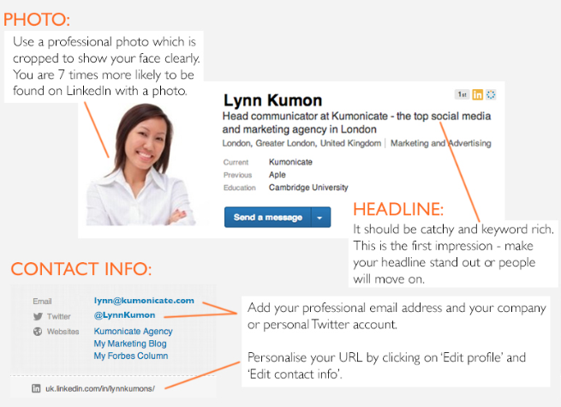
How to build a good profile

Slide 5
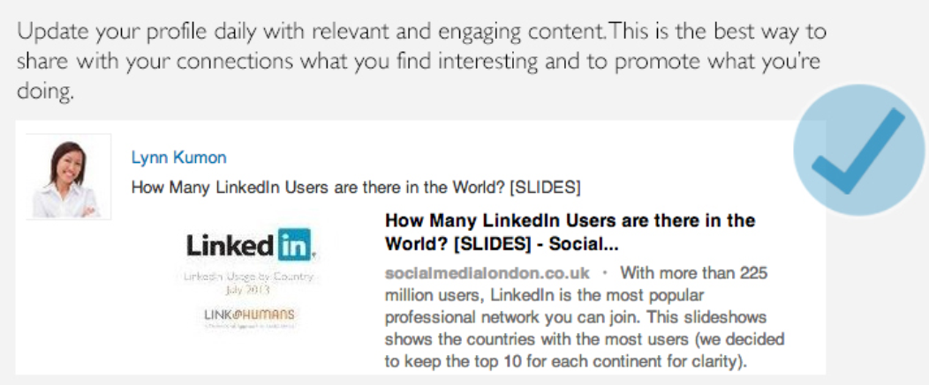
Regular Activity

