Slide 1
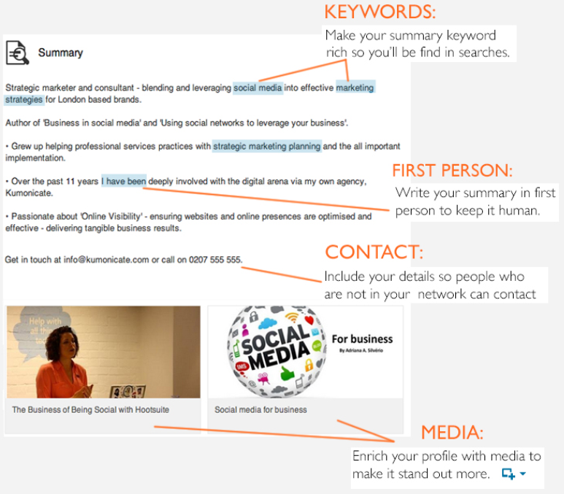
Summary

Slide 2
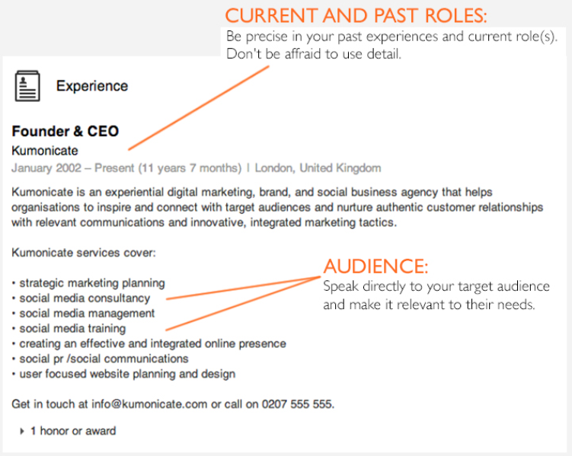
Detail

Slide 3
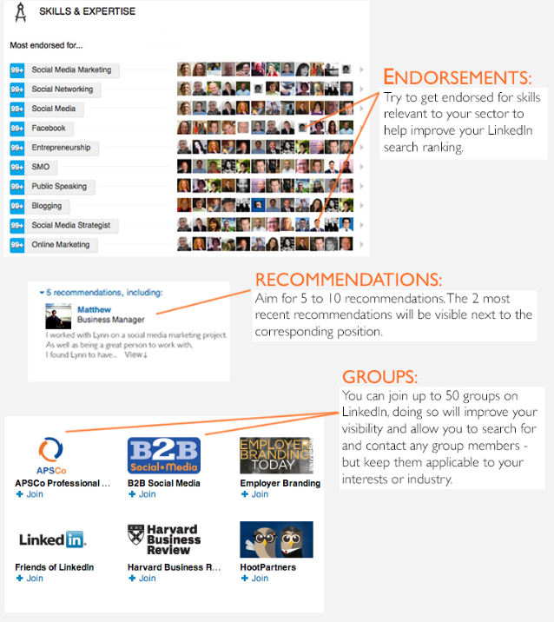
Awards and Recommendations

Slide 4

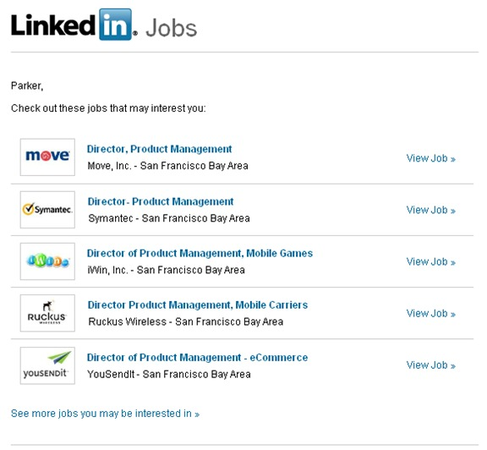


Benefits of using
Job Email Alerts
Connecting with Professionals

