Slide 1
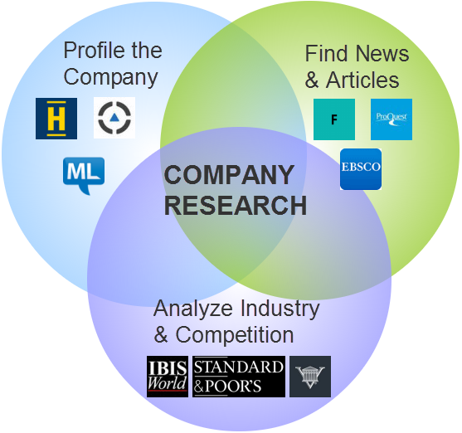
Benefits of using
Conducting Company Research
Recommendations

Slide 2
Benefits of using
Letting Companies Find You
Connecting With Other Students

Slide 3
Benefits of using
Landing International Jobs
Conclusion? Get yourself signed up!

Slide 4
Location
& Salary
Booleans
Search key words to narrow down the jobs to suit you
“IT” AND (“Apprentice” OR “Administrator”)
Be realistic about salary level for your experience
Think about the daily commute and distance from your home to work

